Slide 1

Simple Linear Regression Model
Reading: 1.1
exercises: Ch.1: 1,5-8, 15, 17, 19
Assigned: hw 3
Producer: dr. mario
img credit: alex riegert-waters

Slide 2
Prerequisites for the Model
Single Quantitative Response Variable Y
Single Quantitative Predictor Variable X
Scatterplot of Y versus X (Book Does Side-by-Side Boxplots)
Evidence that a Straight Line is Reasonable for Modeling the Relationship between Y and X

Slide 3
Example: Honda Accords
Question: Is there a linear relationship between the age of an Accord and the price of an Accord?
Both Variables are Quantitative
Which One is Response?
Scatter Plot of price versus age or price on age Shows Evidence of a Linear Relationship

Slide 4
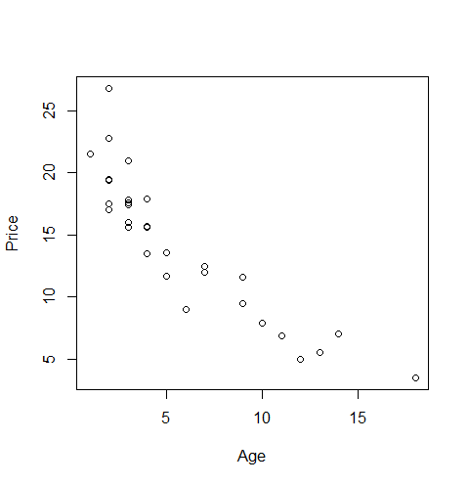
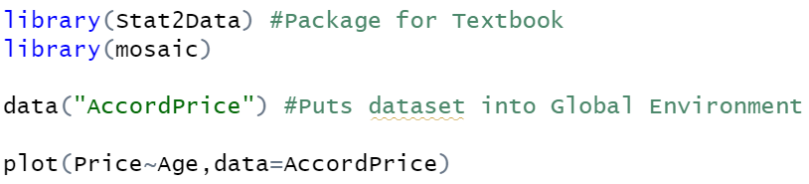
Example: Honda Accord Price

Slide 5

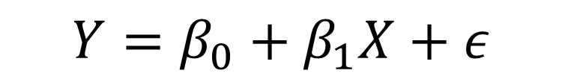


Simple Linear Regression Model
General Form
Simple Linear Regression
Shape Depends on y-Intercept $β_{0}$ and Slope $β_{1}$
$$Y=f\left(X\right)+ε$$
$$=μ_{Y}+ε$$
Mean of Y Given X or E[Y|X]
$$Y=β_{0}+β_{1}X+ε$$

Slide 6

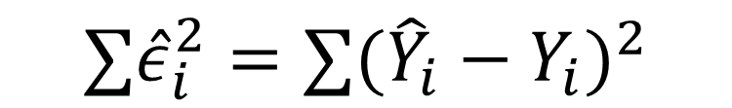
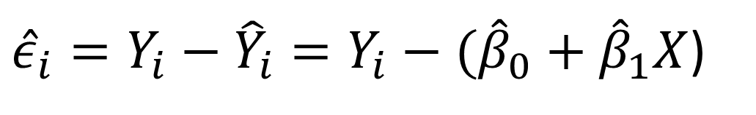
Fitting Model to Data
Fitted (Estimated) Model
Residual for i^{th} Car
Sum of Squared Errors (SSE)
$$\hat{Y}={\hat{β}}_{0}+{\hat{β}}_{1}X$$
${\hat{ε}}_{i}={Y_{i}−\hat{Y}}_{i}=Y_{i}−({\hat{β}}_{0}+{\hat{β}}_{1}X$)
$$∑{\hat{ε}}_{i}^{2}={{∑(\hat{Y}}_{i}−Y_{i})}^{2}$$

Slide 7


Fitting Model to Data
Least Squares Regression: Choose Estimates ${\hat{β}}_{0}$ and ${\hat{β}}_{1}$ such that SSE is as small as possible
Interpretation of $\hat{Y}$: Expected value or predicted value of Y given a known value for X
Interpretation of ${\hat{β}}_{0}$: The predicted value of Y given that X=0
Interpretation of ${\hat{β}}_{1}$: The amount by which our expected value of Y would change if we increase X by 1 unit
$$\hat{Y}={\hat{β}}_{0}+{\hat{β}}_{1}X$$

Slide 8


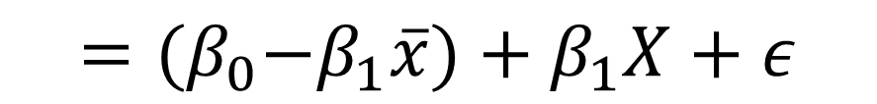
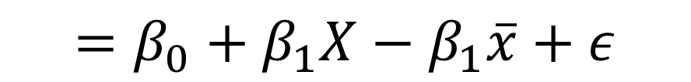
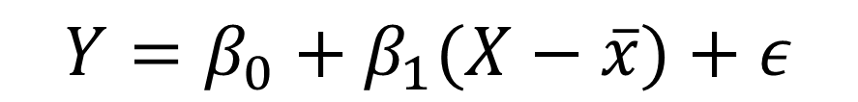
Centering Data
Suppose we replace our Predictor $X$ with $X−\overline{x}$
Notice
$$Y=β_{0}+β_{1}(X−\overline{x})+ε$$
$$=β_{0}+β_{1}X−β_{1}\overline{x}+ε$$
$$={(β}_{0}−β_{1}\overline{x})+β_{1}X+ε$$
Slope Is Unaffected
Y-intercept Will Change
$$=β_{0}^{∗}+β_{1}X+ε$$

Slide 9
Thank You
Make Reasonable Decisions

